Slide 1
LLAMA.CPP AND LLAMA–BENCHMARK
CS 431
Fall 2025
4 December 2025
Marko Markoc ᐧ Brady Mcatee ᐧ Anant Prakash Pathak ᐧ Reid Wahl ᐧ Aaron Willett

Slide 2

CS 431
4 December 2025
Plain C/C++ llama implementation with a goal of enabling LLM inference with minimal setup and state-of-the-art performance on a wide range of hardware - locally and in the cloud.

Slide 3
CS 431
Project will evaluate
4 December 2025
How much faster is GPU acceleration compared to CPU-only inference for LLM workloads?
Does llama.cpp achieve linear scaling as we add multiple GPUs?
What is the impact of partial GPU offloading versus full offloading on inference performance?
Does tensor split configuration (balanced vs. weighted) affect multi-GPU performance?
Same model family but different parameters(0.6B vs 4B vs 8B), impact?
Performance difference between L40s and A30

Slide 4
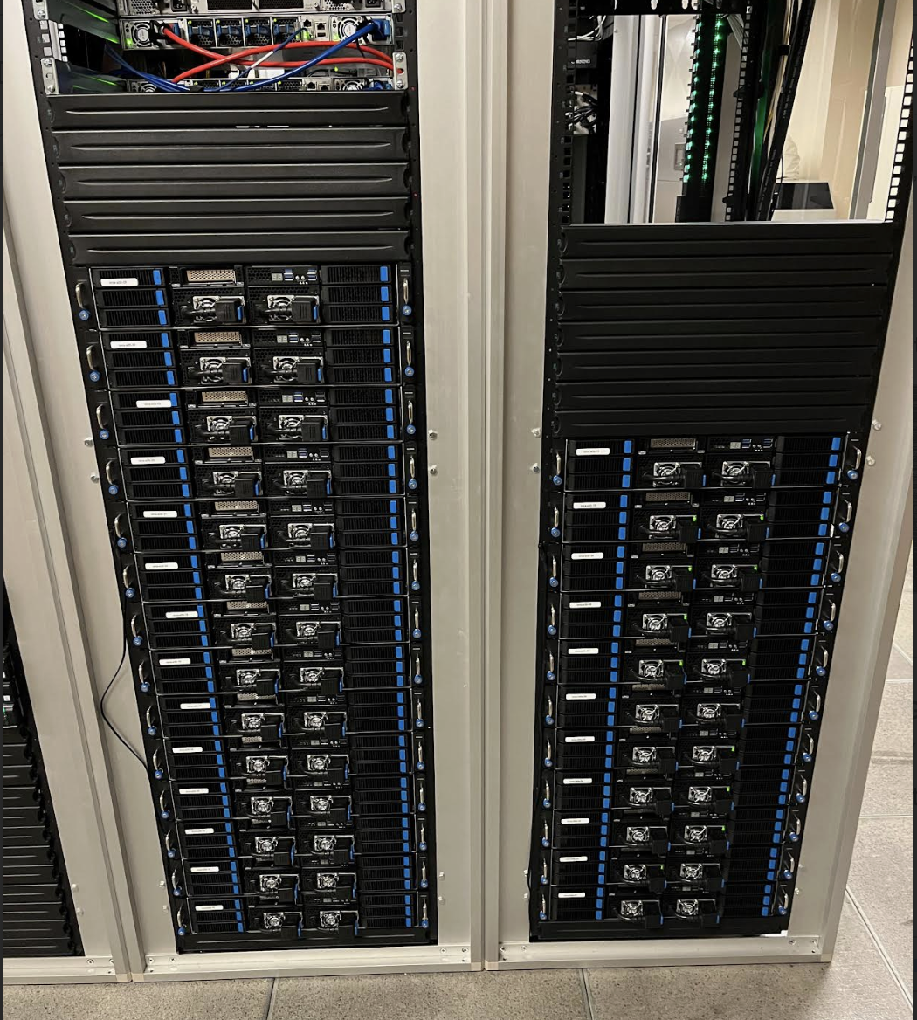
CS 431
Platform used
4 December 2025
ORCA HPC cluster node:
AMD EPYC 9534 64-Core Processor
64 threads
568 GB of RAM
4 x Nvidia A30
3584 cores
24GB memory
4 x Nvidia L40s
18176 cores
48GB memory

Slide 5
CS 431
Llama-cpp build
4 December 2025
Dependencies
OpenBLAS 0.3.29
CUDA 12.9.0
Build options
cmake -B build -DGGML_BLAS=ON -DGGML_BLAS_VENDOR=OpenBLAS -DGGML_CUDA=ON

Slide 6
CS 431
Model
4 December 2025
Qwen3-8B-Q5_K_M
offering a comprehensive suite of dense and mixture-of-experts (MoE) models. Built upon extensive training, Qwen3 delivers groundbreaking advancements in reasoning, instruction-following, agent capabilities, and multilingual support
Number of Parameters: 8.2B
Number of Layers: 36

Slide 7
CS 431
llama-bench
4 December 2025
CLI tool for benchmarking llama.cpp performance with various parameters
Part of a llama.cpp installation
Used as driver for our experiments – don’t reinvent the wheel
Three test modes:
Prompt processing (pp): Process a prompt in batches
Specify number of tokens per prompt (--n-prompt=N; default: 512)
Text generation (tg): Generate a sequence of tokens
Specify number of tokens in generated sequence (--n-gen=N; default: 128)
Mixed (pg): Process a prompt and then generate a sequence of tokens
Specify number of tokens in prompt and response
-pg=M,N; disabled by default

Slide 8
CS 431
llama-bench
4 December 2025
Survey of features
Control size of prompts, responses (generated sequences), and batches
Control number of threads (--threads=N; default: 4)
Control how tensors are split across multiple GPUs
--tensor-split=3,2 puts 60% on device 0 and 40% on device 1
--split-mode can be set to none, layer, or row
Control number of layers offloaded to GPUs (--n-gpu-layers=N; default: 99)

Slide 9
CS 431
llama-bench
4 December 2025
Survey of features (cont.)
Repeat all tests a given number of times (default: 5)
Ex: --repetitions=10 repeats every requested test 10 times
Larger sample size for statistical analysis
Run multiple tests per invocation to compare varying settings
Ex: --n-prompt=16,32,64,128 runs tests with prompt sizes 16, 32, 64, and 128.
Output collects test results into one table – useful for scaling tests, etc.
Can create a “test matrix.” Examples:
Vary the model and the generated token sequence length
Vary the prompt size and the number of threads
Output results in various native formats
CSV, JSON, JSON Lines, Markdown, SQL
Makes analysis and presentation easy
Limitation: Can only specify one format per run. Can’t get same results in CSV and MD.

Slide 10
CS 431
llama-bench
4 December 2025
How we used it
Offloading to single GPU, across model sizes
Layers offloaded: 0, 10, all
Model sizes (Qwen3): 0.6B, 4B, 8B
CPU using OpenBLAS backend
Tensor split (or number of GPUs)
Four GPUs available
Splits:
One GPU: 100% / 0% / 0% / 0%
Two GPUs (balanced): 50% / 50% / 0% / 0%
Four GPUs (balanced): 25% / 25% / 25% / 25%
Four GPUs (weighted): 31.25% / 31.25% / 18.75% / 18.75% (ratio: 5:5:3:3)
Note: Parameters that are not noted remained fixed
Profiling CPU/GPU execution
CPU: gperftools
GPU: nvidia-nsight-systems

Slide 11
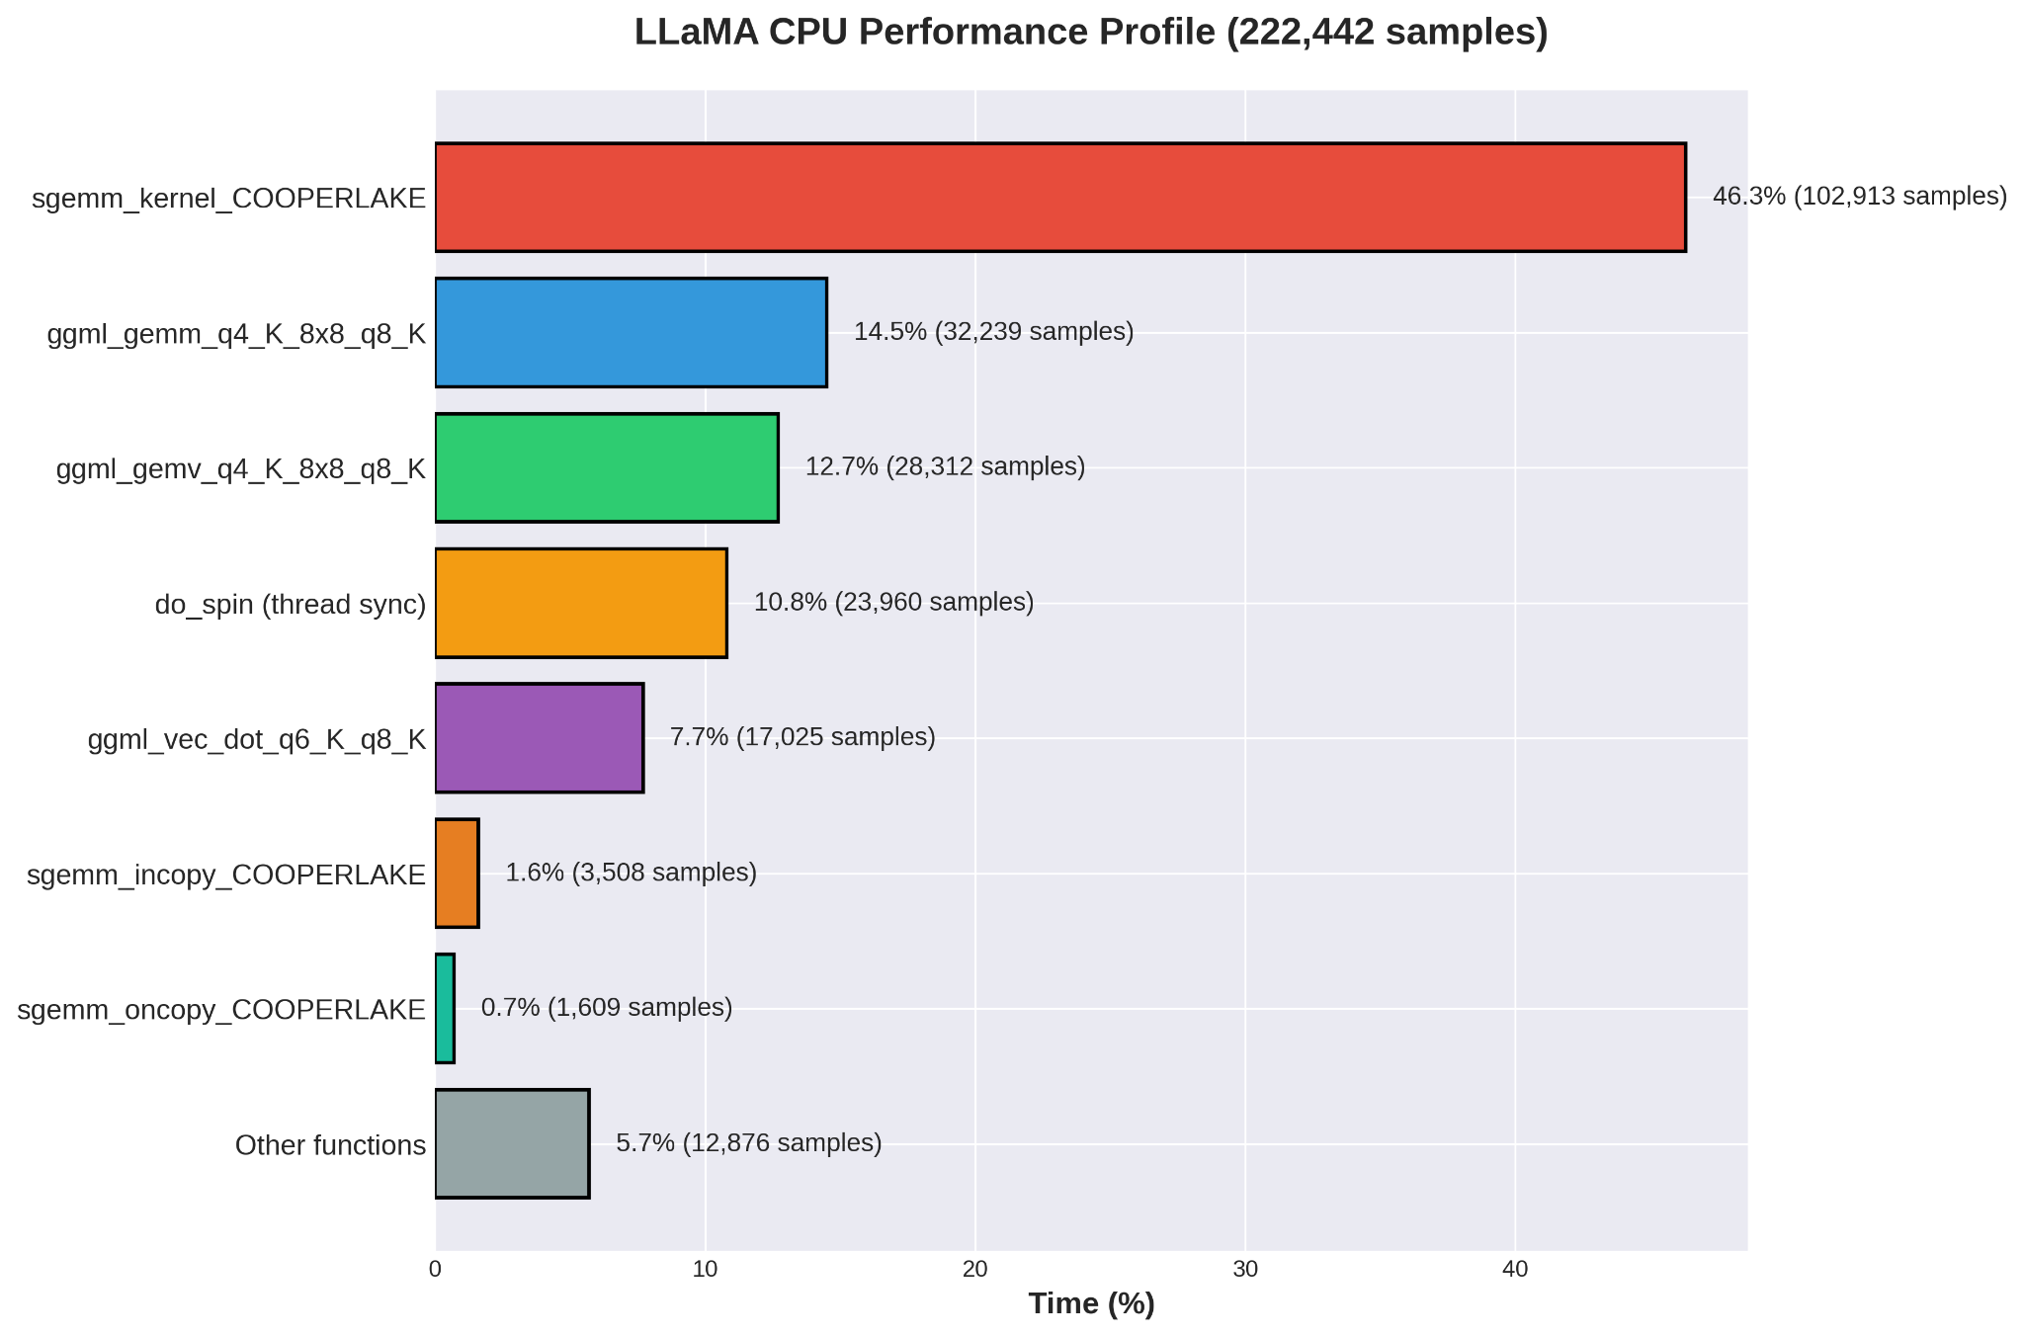
CS 431
CPU Profiling with gperftools
4 December 2025

Slide 12
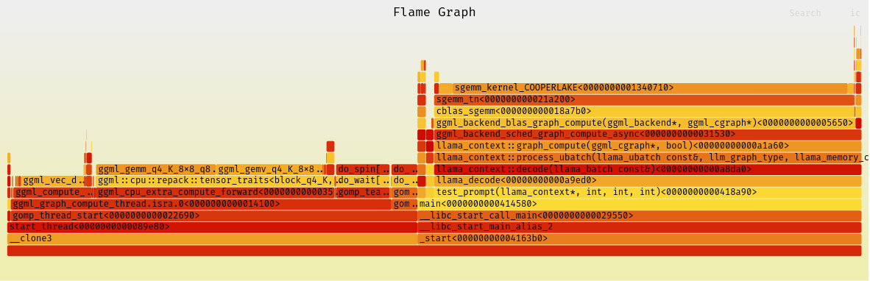
CS 431
CPU Profiling with gperftools
4 December 2025

Slide 13
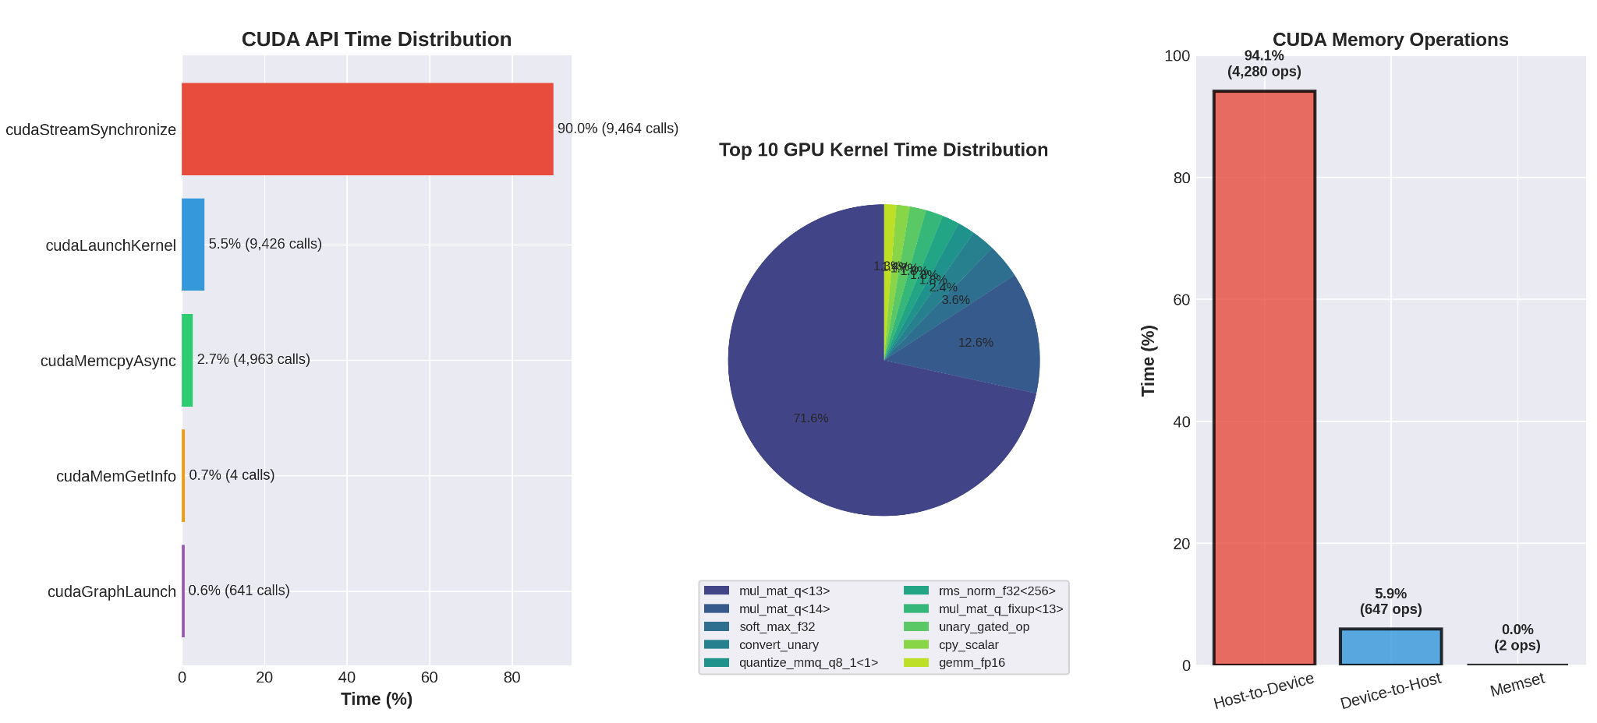
CS 431
GPU Profiling
4 December 2025

Slide 14
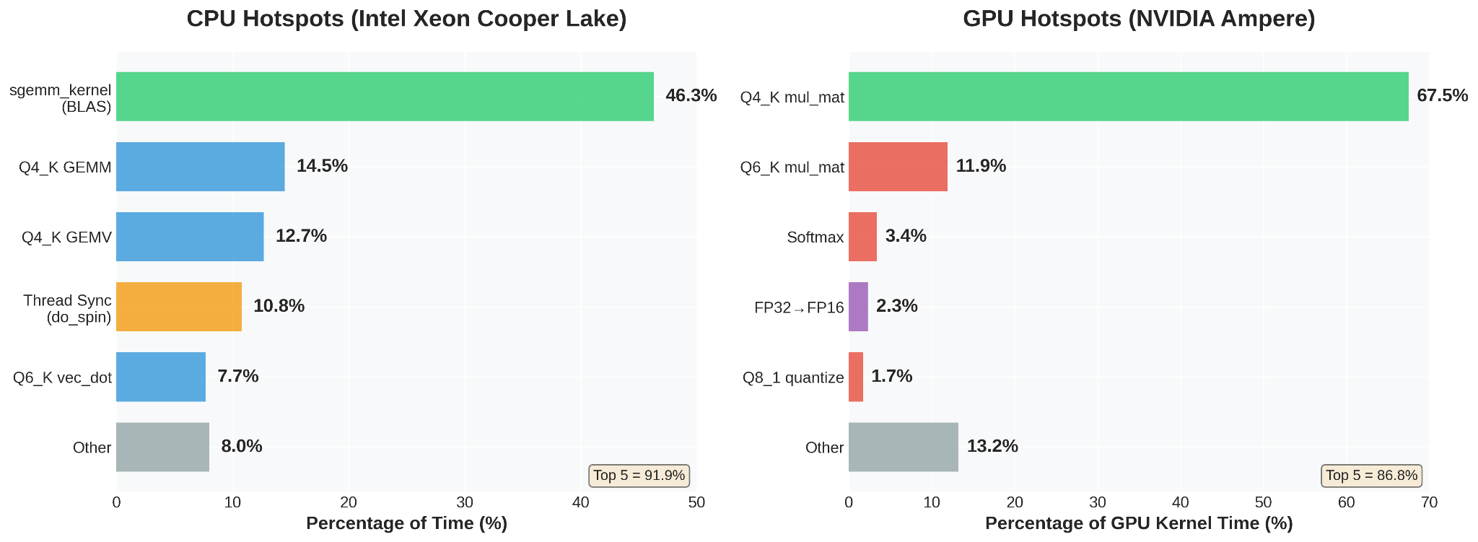
CS 431
CPU vs GPU Profiles
4 December 2025

Slide 15
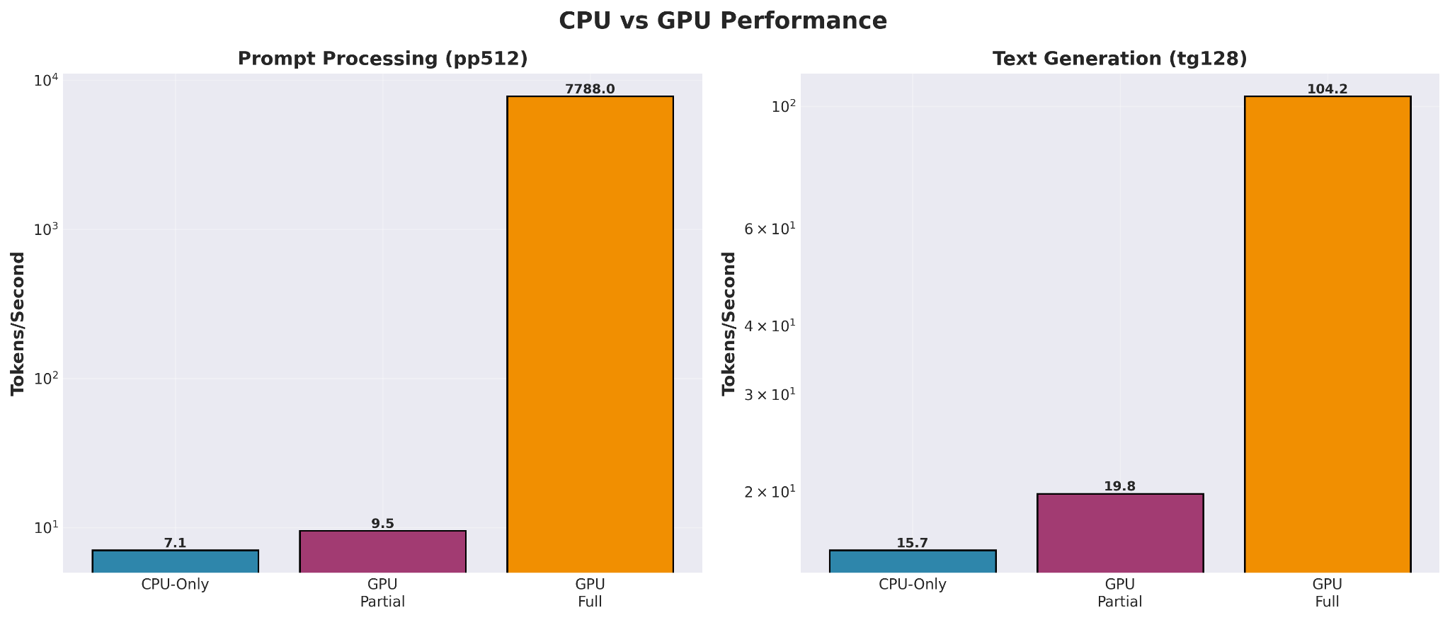
CS 431
4 December 2025
Notes:
Discussing CPU vs GPU Performance - On the left, we see prompt processing performance measured in tokens per second - The CPU-only baseline achieves just 7.1 tokens per second - Partial GPU offloading— where only 10 of the 36 model layers run on the GPU—we see minimal improvement to 9.5 t/s - However, with full GPU offloading, performance explodes to 7,788 tokens per second - Note the logarithmic scale—this represents over a 1000x performance improvement - Text generation shows a different pattern - CPU achieves 15.7 t/s, partial GPU reaches 19.8 t/s, and full GPU hits 104.2 t/s - While still significant at 6.6x speedup, this is far less dramatic than prompt processing - This difference reveals an important architectural insight:
!! prompt processing is highly parallelizable, while autoregressive text generation has inherent sequential dependencies - Notice that partial GPU offloading performs poorly— worse than you'd expect from interpolating between CPU and GPU - This is due to CPU-GPU data transfer overhead, which we'll discuss further This sets our baseline understanding. Now let's quantify these speedups more precisely.

Slide 16
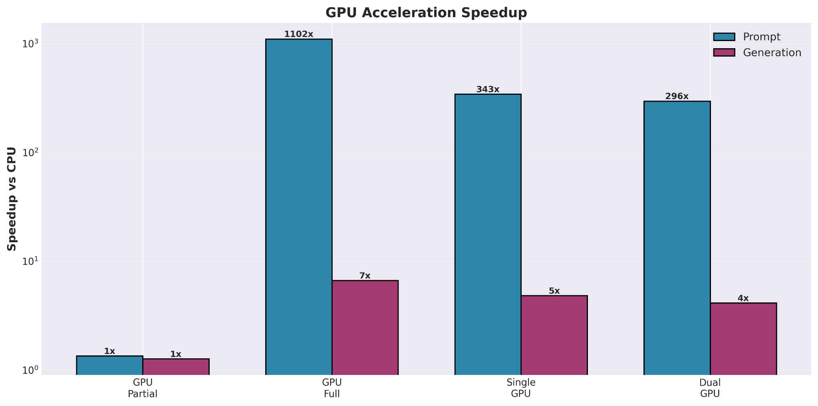
CS 431
4 December 2025
Notes:
GPU Acceleration Speedup
This chart directly quantifies the acceleration factors we achieve with GPU offloading, using our CPU baseline as the reference point. - Partial GPU offloading shows only 1.35x speedup for prompts and 1.27x for generation - This minimal improvement despite using GPU resources demonstrates the cost of hybrid CPU-GPU execution
- Data must be continuously shuttled between CPU and GPU memory, creating a bottleneck - Full GPU offloading on the L40S delivers a staggering 1102x speedup for prompt processing
- Text generation sees a more modest but still impressive 7x speedup
- The logarithmic scale is necessary here—these bars would be impossible to display linearly - Switching to the A30 GPU, we see 343x speedup for prompts - While impressive, this is roughly one-third the performance of the L40S - Generation speedup is 5x, again lower than L40S
- Interestingly, using two GPUs actually decreases performance to 296x
- This foreshadows our multi-GPU analysis and suggests communication overhead The key takeaway: for inference workloads on small models like this 8B parameter model, a single powerful GPU is optimal. The all-or-nothing approach wins decisively. Let's examine that multi-GPU phenomenon more closely.

Slide 17
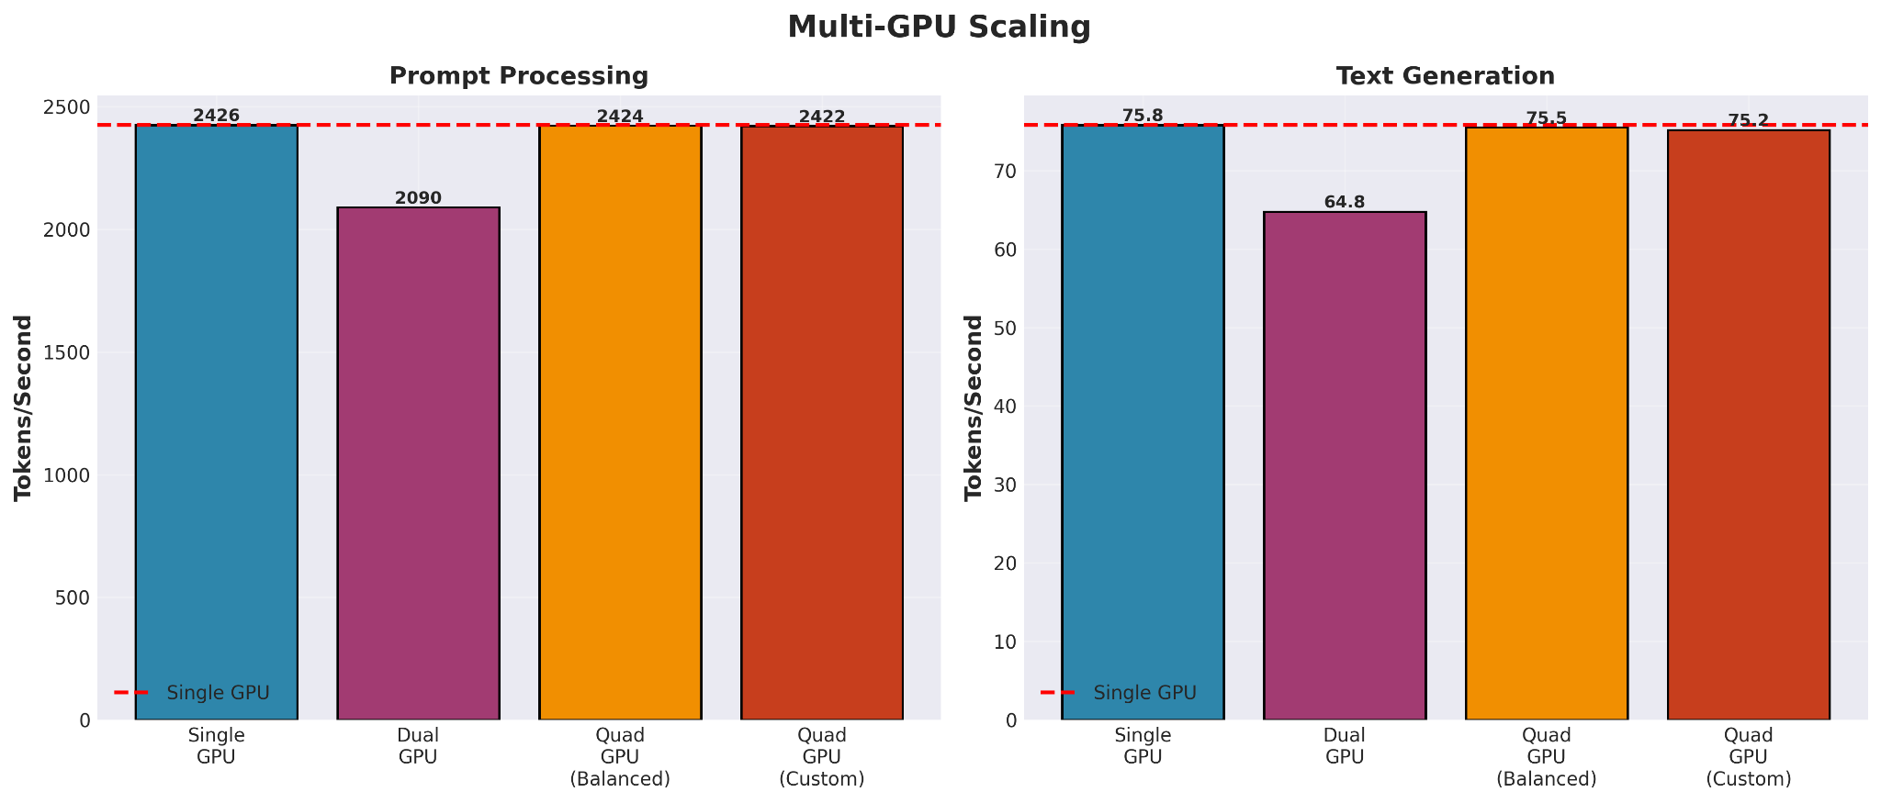
CS 431
4 December 2025
Notes:
Multi-GPU Scaling
Conventional wisdom suggests more GPUs should mean better performance. Our data tells a different story for inference on 8 billion parameter models.
- We establish our single GPU baseline at 2,426 tokens per second—shown by the red dashed line - This is our target: can multiple GPUs exceed this?
- With two GPUs and an 8-8-0-0 tensor split, we see performance drop to 2,090 t/s
- That's a 14% performance loss, not a gain
- For text generation, we drop from 75.8 to 64.8 tokens per second - Distributing evenly across four GPUs brings us back close to single-GPU performance: 2,424 t/s - But we're using 4x the hardware for essentially the same throughput
- This represents 0% scaling efficiency - Even with a custom weighted distribution, we see 2,422 t/s
- No improvement over the balanced approach Why does this happen? For an 8 billion parameter model:
- The model fits comfortably in a single GPU's memory (5.44 GB VRAM)
- Inter-GPU communication overhead exceeds any parallelism benefits
- The model simply isn't large enough to benefit from distribution
- Each GPU synchronization point adds latency
This would change dramatically with larger models— a 70B or 405B parameter model would show different scaling characteristics.
TAKEAWAY
For inference optimization: Match your GPU count to your model size, not the other way around. More GPUs ≠ better performance for small models.

Slide 18
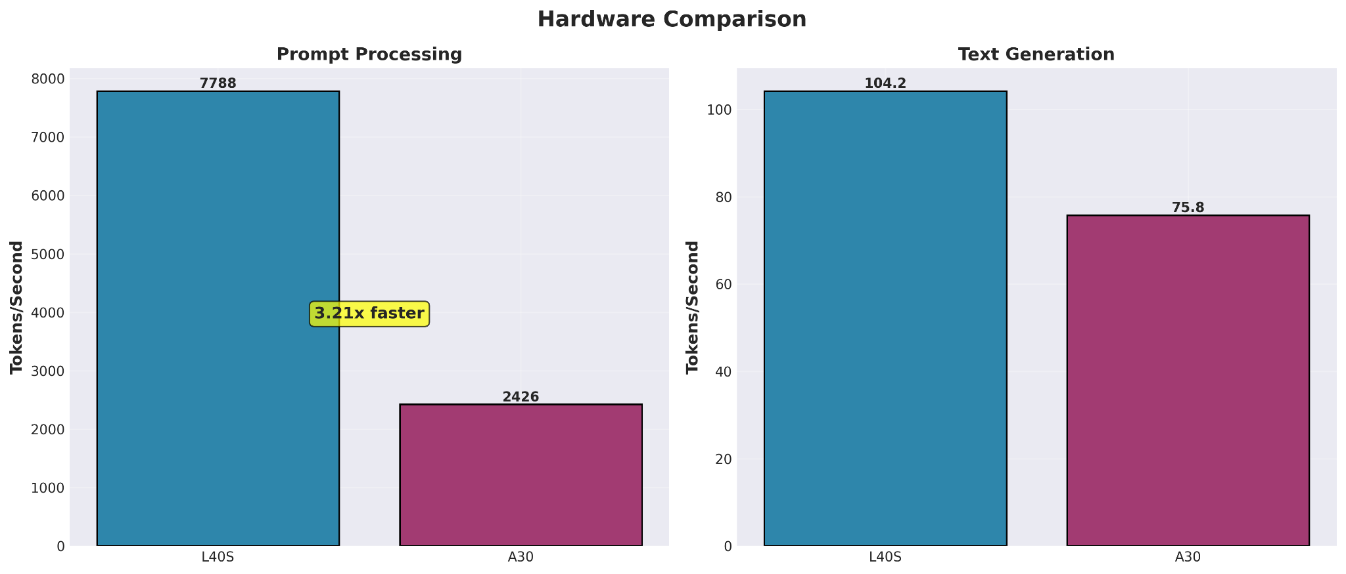
CS 431
4 December 2025
Notes:
Hardware Comparison
This figure represents out hardware analysis for two NVIDIA data center GPUs: the A30 and L40S. Both are enterprise-grade, but they target different workloads.
- The L40S achieves 7,788 tokens per second compared to the A30's 2,426 t/s
- That's a 3.21x performance advantage—substantial for real-world applications - This difference stems from several architectural factors:
L40S has higher compute capability (8.9 vs 8.0)
Greater memory bandwidth
More CUDA cores optimized for inference workloads
- For text generation, L40S achieves 104.2 t/s versus A30's 75.8 t/s
- This is a more modest 1.38x speedup
- The gap narrows because text generation is memory-bandwidth bound and sequential
- The A30's tensor cores are still competitive for this workload
For production inference serving, the L40S is the clear choice.

Slide 19
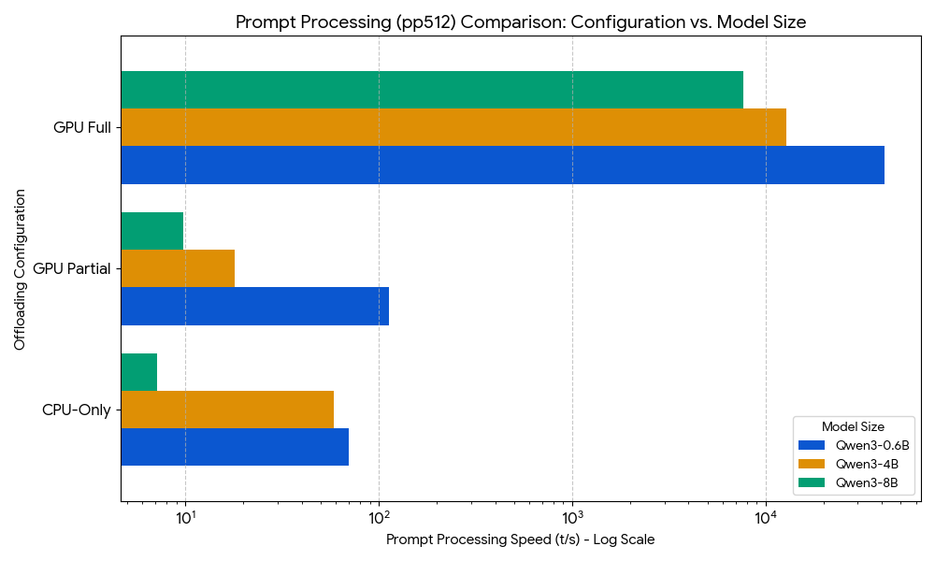
Qwen3 - 0.6B vs 4B vs 8B : prompt processing
CS 431
4 December 2025

Slide 20
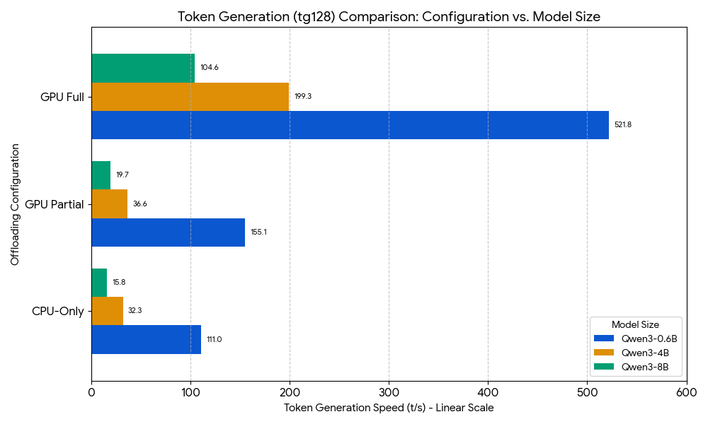
Qwen3 - 0.6B vs 4B vs 8B : token generation
CS 431
4 December 2025

Slide 21
Summary
CS 431
4 December 2025
Massive GPU Speedup: Full GPU Offloading provided over 1000x acceleration for Prompt Processing (pp512) compared to the CPU-Only base.
Offloading is Essential: Full GPU Offloading is required for peak performance; Partial Offloading showed only marginal gains.
Token Generation Bottleneck: The sequential nature of Text Generation (tg128) makes it the performance bottleneck, limiting overall chat speed due to Memory Bandwidth constraints.
The CPU is limited by the speed of calculation (spending 46.3% of time on matrix math), while the GPU is limited by memory bandwidth—its fast cores wait for the memory system to load model parameters for each sequential token generated.
Hardware Advantage: The NVIDIA L40S delivered superior performance, being 3.21x faster at prompt processing than the A30 GPU.
Scaling & Strategy: Smaller models (e.g., Qwen3-0.6B) are faster overall. Llama.cpp's multi-GPU strategy (Layer Slicing) showed near-zero speedup in generation, highlighting the need for true Tensor Parallelism (found in frameworks like vLLM/ExLlamaV2) for efficient multi-GPU scaling.

